Slide 1
CI401
Introduction to programming
Enhanced for Loop
&
Making Choices

Slide 2
Learning Outcomes
Understand the three basic control structures in programming.
Use the enhanced for loop to repeat actions.
Making choices
Apply if-else statements to control which code is executed.
Use switch-case statements to handle multiple choices based on a value.
Combine these features with what you’ve learned so far to create more interactive programs.

Slide 3
Three Basic Control Structures
Every program, no matter how complex, is built from just three types of control structures (basic unit of programming logic):
Sequence → perform actions in order, step by step, with no skipping.
Selection (Decision) → ask a question and choose one of several possible actions (e.g., if…else, switch…case).
Loop (Repetition) → repeat actions.
These three structures form the backbone of all programming logic.

Slide 4
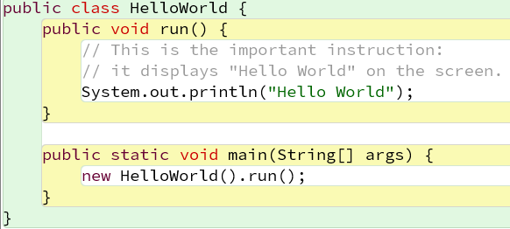
Our First Program: HelloWorld
What you see is mostly Java code.
The colours and layout make the code easier to read.
For now, focus on the key instruction:
System.out.println("Hello World");
This instruction tells Java to display Hello World on the screen.
📦The accompanying project code includes comments that explain what you are seeing and highlight a few useful things to notice.
You do not need to understand all of the code yet - we will learn about it step by step.

Slide 5
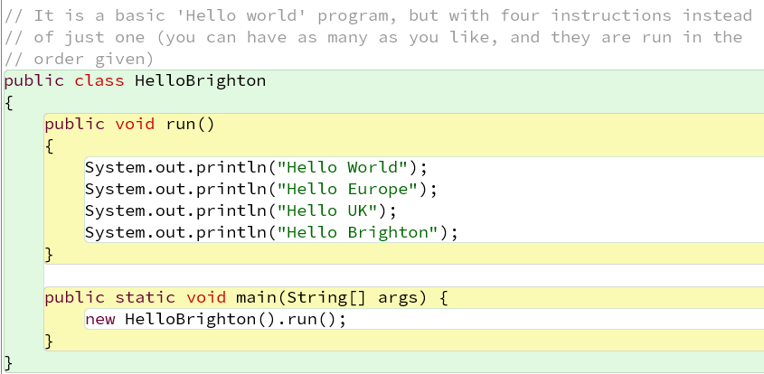
From HelloWorld to HelloBrighton
Now, instead of printing a single message, let’s print a list of places.
This moves us from one instruction towards repeating a set of instructions. ➡️
🤔 Putting our lazy hat on, what do you notice?

Slide 6
HelloBrighton: Spotting Duplication
We asked the computer to print four things instead of just one
But this is not a great way to do this - lots of repetition
We typed System.out.println(“Hello”) four times!
🤔 Wouldn’t it be better to say
Here is a list of places, say “Hello” to each one ?

Slide 7
Good programmers are lazy
Programmers don’t like doing anything more than once
Whenever you find yourself repeating something in your code, you should think “Is there a way of doing this without repeating myself?”
Lots of the programming techniques we will learn are ways to avoid repeating ourselves – ways of being lazy🥳
In this section we will look at one of the most important ways - loops

Slide 8
Loops

Slide 9
A Little Preparation
If you are new to variables and types, a short introduction is available to help you with this section. See the slide “Variables and Types - The Basics”.
It covers just the basics you need to understand the examples here. It is not a full introduction to variables and types - we will cover these properly later in the module.

Slide 10
🔄Loop Structure
Also called repetition or iteration
A loop repeats a set of actions.
For some loops, a condition determines whether the repetition continues. If the condition becomes false, the loop stops.
condition
true
Loop body
false
A common loop structure

Slide 11
Loops in Java
Java provides four kinds of loops. They don't all work in exactly the same way:
enhanced for (for-each) → loop through items in a collection/array
for → repeat a block a fixed number of times
while → repeat while a condition is true (test before running)
do while → repeat while a condition is true (test after running)

Slide 12
Enhanced For Loop (for-each loop)
Used to iterate through an array or a collection, one element at a time.
Simpler and safer than a normal for loop when you just want to read items.
Notice the pair of curly brackets { } around the loop body.
Syntax:
for (dataType variable : arrayOrCollection) {
// loop body - code to use 'variable'
}
arrayOrCollection
 |  |  |  |  | ……
variable

Slide 13
How the Enhanced For Loop Works
for (String place : placeList) {
System.out.println("Hello ” + place);
}
placeList
World | Europe | UK | Brighton
place
World
Europe
UK
Brighton
Hello World
Hello Europe
Hello UK
Hello Brighton

Slide 14
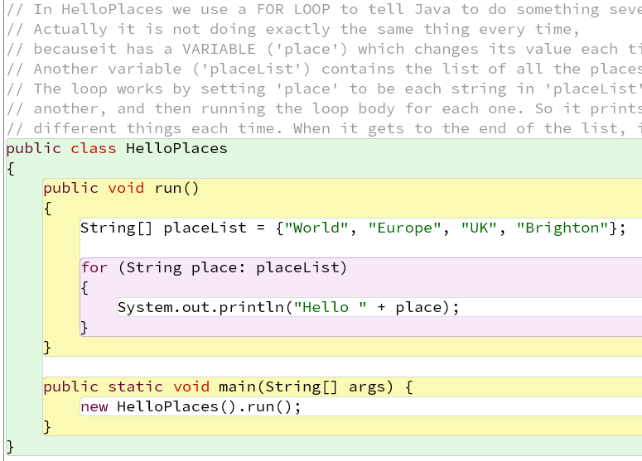
HelloPlaces : Using Enhanced For Loop
Remember HelloBrighton? Now let’s print a list of places efficiently. Each place is printed automatically, one by one.
HelloPlaces introduces three new things to achieve this:
a list of places to say hello to
names for information (data) we are using, so we can refer to things in different parts of the code
A for-each loop - a way of running the same statements several times
💡Notice: The enhanced for loop reduces duplication and keeps your code neat - we now only say System.out.println(“Hello”) once

Slide 15
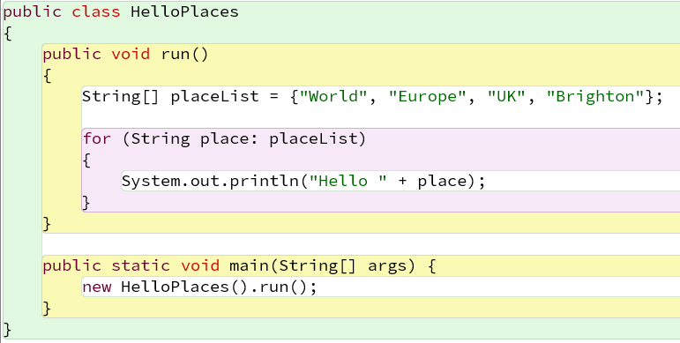
HelloPlaces : An Array
Here is our list of places to say “Hello” to.
It has four strings in it - it could have more or fewer.
Notice the punctuation: the pair of curly brackets, the commas between the strings, and a semicolon at the ends.
The technical word for a list like this is an array.

Slide 16
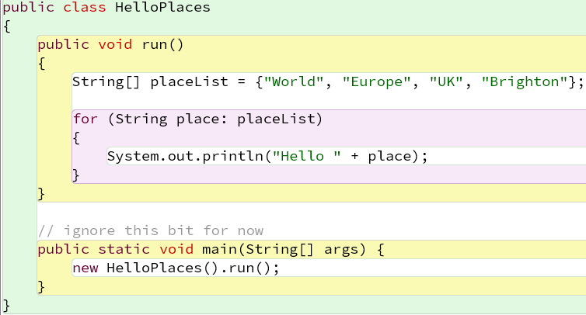
HelloPlaces : Boxes for Data (Variables)
Our code also has two boxes for data - placeList and place.
We give each box a name, so we can refer to the data stored in it.
We can put data into a box and look up the data stored in it.
We can do this many times in our program, but we must put data into a box before we try to look up what is in it.
The technical word for a named box for data is a variable (which comes from maths – x, y etc in algebra).

Slide 17
HelloPlaces: Creating placeList
The first instruction in our program tells Java three things:
  We use placeList as the variable name (box name).
  The kind of data we are going to store in placeList is a list of strings (String[] means ‘list of strings’ or ‘array of strings’ in Java)
  We want to create a particular array of strings containing place names and put it in the box.
The first two things are called declaring the variable; the third is called initialising it.
Variable declarations like this are the most common way of creating variables.

Slide 18
HelloPlaces : The Enhanced For loop
The second instruction is the for loop.
This has three key parts:
  The first line, with the word for and some stuff in round brackets.
  The instructions between the pair of curly brackets - in this case, just one: the println statement.
  The loop repeats the instructions in the curly brackets.

Slide 19
HelloPlaces: Breaking Down the Enhanced for Loop
A for loop runs the instructions in the curly brackets - the loop body - multiple times.
The first line tells it how to do that.
In this case it says
  Declare a new variable called place that can hold a string
  Look in the box called placeList and get its array of strings.
  For each string in the array, copy the string into the place box and run the loop body.

Slide 20
HelloPlaces – Running the Loop Body
When the body runs, it has our familiar println instruction
But notice the thing it prints is now a ‘sum’ which adds the string ‘Hello ’ to whatever is in the box place (which we told Java is also a string)
Each time the loop runs, the value in place changes
So the println instruction prints something different

Slide 21
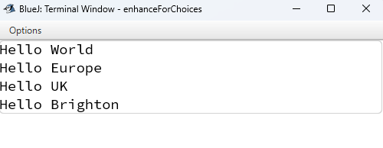
HelloPlaces – Running The Program
When we run HelloPlaces, it does exactly what HelloBrighton did
Which is a complete anti-climax
But if you change the list to have, say, 10 places in it, it will print them all
And all with only one println statement
And it is only one change to make it say ‘Bonjour’ instead of ‘Hello’

Slide 22
Lazy? Us??
Of course, we aren’t really doing this because we are lazy!
We are trying to write code that is concise and general
This makes it easier to understand, test, re-use and modify
It is sometimes a bit of effort to work out how to do it, but it is worth it for all but the smallest programs
Being ‘lazy’ produces better code!

Slide 23
The perils of copy-paste
“Who cares about writing ‘System.out.println(“Hello ’ four times? I can just copy/paste it.”;
“And I can grab whole chunks of code from web tutorials which do exactly what I need.”
BUT
  Testing and modifying code which is repeated in many places is itself very repetitive and difficult
  Using code without understanding it is very dangerous - it may not do exactly what you need, and it may not work at all!
  Using other people’s code in a professional context requires their permission (and usually a paid licence)
  Your code quality will be low, so other people won’t want to re-use it (which may be a key source of reputation and income in your professional life)

Slide 24
Making Choices
Selection structure (decision structure),
ask a question, take one of two/multi actions.

Slide 25
Making choices in a program
We have seen how in a program we can specify sequences of instructions, and create loops to run the same instructions more than once.
Now we will look at how to make choices about alternative sets of instructions to run in different circumstances
The simplest way to do this is with an if statement. ⚖️
Another way to make choices is switch statement. 🗂️
Notes:
The purpose of the if statement is to make decisions, and execute different parts of your program depending on a boolean true/false value.
The simplest way to make choices in a program is with an if statement. Here’s how it works in Java.

Slide 26
⚖️ Simple If Statements
Syntax:
if (test) {
// true code block: instructions to run if the test is true
} else {
// false code block: instructions to run if the test is false (optional)
}
Start with the keyword if, followed by a test/condition in round brackets.
Curly brackets {} enclose the instructions to run when the condition is true.
The else part is optional - use it when you want a different code block to run when the condition is false.
Read it as: “If the test is true, run the true code block; otherwise, run the else code block if there is one.”
Pay attention to the round () and curly {} brackets.
Notes:
if ( test )
{
instructions to run if the test is true
}
------------------------------
if ( test ) {
instructions to run if test is true
} else {
instructions to run if test is false
}

Slide 27
How an if Statement Works
The program tests a condition.
If the condition is true, the true code block runs.
If the condition is false, the else code block runs - if there is one.
After the if statement, the program continues with the code after it.
if (test) {
// true code block
} else {
// false code block
}
true
test
(condition)
false
true block
false block
if (test) {
// true code block
}
Code after if-else
Notes:
Think of it as a fork in the road: the program chooses one path depending on the condition.

Slide 28
Test in if statements
The test in an if statement is something that can be true or false.
The simplest test is to ask whether two things are the same.
Testing fixed values, such as 2 equals 2 (written in Java as 2 == 2), or “Brighton" equals "Hove" is not very useful because we already know the answer.
Tests become useful when one or both values come from variables, because their values may not be known in advance.
For example, age equals 18 or place equals “Brighton" can be true or false depending on the values stored in the variables (i.e. what is stored in the age or place box) when the test runs.
Notes:
For example, age equals 18, written as age == 18, or place equals "London", written as place.equals("London"), can be true or false depending on the values stored in the variables (i.e. what is stored in the age or place box) when the test runs.

Slide 29
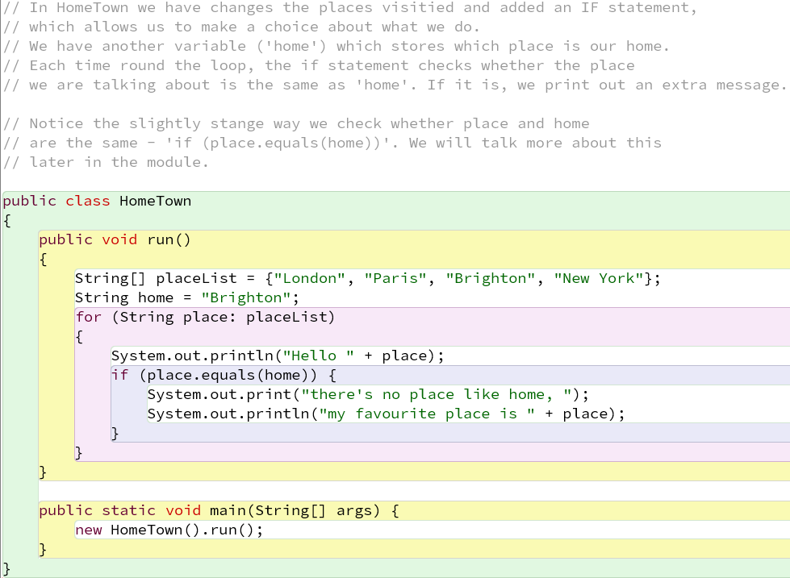
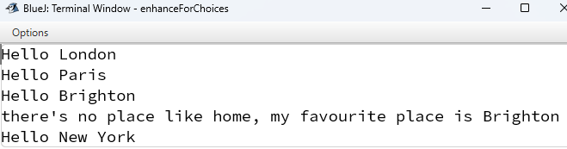
HomeTown : Using If Statements in HelloPlaces
HomeTown is based on HelloPlaces with a few changes:
The list of places has been updated.
A new variable home is introduced, initialized to “Brighton".
An if statement has been added inside the loop body to test each place.
Running HomeTown
Output when we run HomeTown
It prints our list of places as before
But when we get to Brighton, it prints a second message

Slide 30
HomeTown : a New Variable
Here we have added the variable declaration and intialisation statement for home, setting its value to "Brighton"
(You can add new variables whenever you want in your code to store things)
(The name should start with a non-capital letter, and not clash with anything else)

Slide 31
HomeTown : the If Statement
Remember the loop body runs for each string in placeList, with place set to that particular string
So we print the Hello message as before
And then we test whether place is the same as home (place.equals(home) is true if they are the same)
If they are, we run the body of the if statement, and print the additional message
Then we go round the loop again for the next place in the list

Slide 32
Combining Statements
In Java, for loops and if statements are treated as single instructions that can contain blocks of other instructions.
You can freely combine them: an if inside a for, a for inside an if, multiple ifs inside an else, and so on.
The key is correct nesting - curly brackets {…} group instructions together.
BlueJ helps by indenting code inside another block and changing the box colour, making it easier to see the structure.

Slide 33
Chained If Statements : Handling Multiple Conditions
Syntax:
if (test1) {
// code block 1: instructions if test1 is true
} else if (test2) {
// code block 2: instructions if test2 is true
} else if (test3) {
// code block 3: instructions if test3 is true
} else {
// code block 4: instructions if all tests are false
}
test 1
true
Code block 1
false
test 2
true
Code block 2
false
test 3
true
Code block 3
This style lets you check multiple tests in sequence and execute different actions depending on which test passes.
You can include as many else if blocks as needed.
Code block 4
code after
the if-else

Slide 34
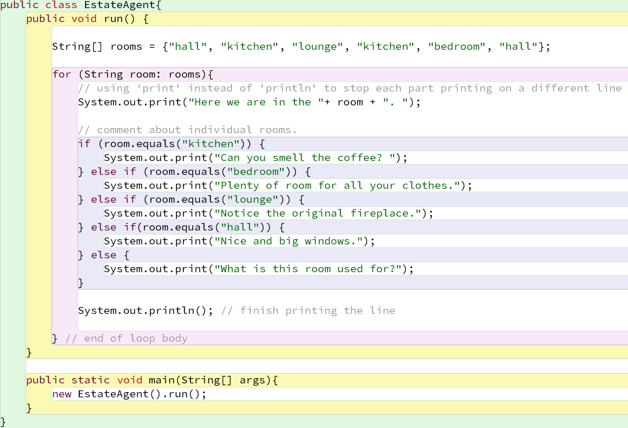
EstateAgent : Multiple Conditions
The EstateAgent class uses a series of if statements to check the value of room and give a different comment for each type of room.
😵‍💫 The code works, but when we are checking one value against several possible choices, there may be a clearer way to write it.
Next: switch

Slide 35
Handling Multiple Conditions : switch
In the EstateAgent class, we see a real example of multiple tests: the program checks room to decide what comment to display.
Using multiple if-else if statements works, but when we are checking the same variable against many possible values, the code can become repetitive and harder to follow – imagine your brain trying to follow 100 if-else statements 😵‍💫!
Java’s switch statement provides a cleaner, more readable way to handle many discrete choices.
✅ Key idea: When you have many tests on the same variable or expression, switch can make the code easier to read and maintain.

Slide 36
🗂️ Multiple Conditions : The switch Statement
Syntax for switch:
A switch statement is like an if statement, except that the part between the round brackets is not a test (something true or false), but an expression which returns a value (usually a number or a String)
The body of the switch statement is a set of cases
Each case is labelled with a possible value of the expression
The instructions are run if the expression’s value is that particular label. Usually the last instruction is the special instruction break;
The default case is optional, like an else statement – what to do if the value of the expression is not any of the case labels
Notice the lack of { … } around the instruction blocks!*.
switch ( expression ) {
case value1:
instructions for value1;
break;
case value2:
instructions for value2;
break;
case value3:
instructions for value3;
break;
......
default:
instructions for no matching case;
}
Notes:
Switch Case – Curly Braces
Notice the lack of { … } around the instructions in each case block.
Braces are not required in a case unless you need to create a separate scope (e.g., to declare local variables that don’t conflict with other cases).
Most of the time, keep it simple without braces.
💡 Tip: Use braces only when necessary — otherwise the code is cleaner and easier to read.

Slide 37
Why We Need break in Switch Statement
Each case in a switch is not automatically isolated - Java will continue executing the next cases after the matching one, unless you tell it to stop.
The break statement ends the current case and jumps out of the switch entirely.
Think of it like saying: “I’m done here, move on to the next instruction outside the switch.”
💡Extra note:
Without break, Java falls through to the next case automatically. This can be useful when multiple cases should share the same code - we’ll see an example of this shortly.
The break in the default case is optional - since it’s the last case, there’s no following case to fall into.
break can also be used inside loops to exit early (covered later).

Slide 38
EstateAgent : Using switch
switch (room) {
case "kitchen":
System.out.print("Can you smell …");
break;
case "bedroom":
System.out.print("Plenty of room …");
break;
case "lounge":
System.out.print("Notice the …");
break;
case “hall":
System.out.print(“Nice and big win…");
break;
default:
System.out.print("What is this…?");
}

Slide 39
Month Lengths : Using switch
switch (month) {
case "april":
case "june":
case "september":
case "november":
System.out.println("30 days");
break;
case "february":
System.out.println("28 days");
break;
default:
System.out.println("31 days");
}
Multiple cases can share the same code block (e.g., April, June, September, November).
break is used to stop fall-through to the next case.
Default handles any values not matched by other cases - all the months not named (and any value that isn’t a month name).

Slide 40
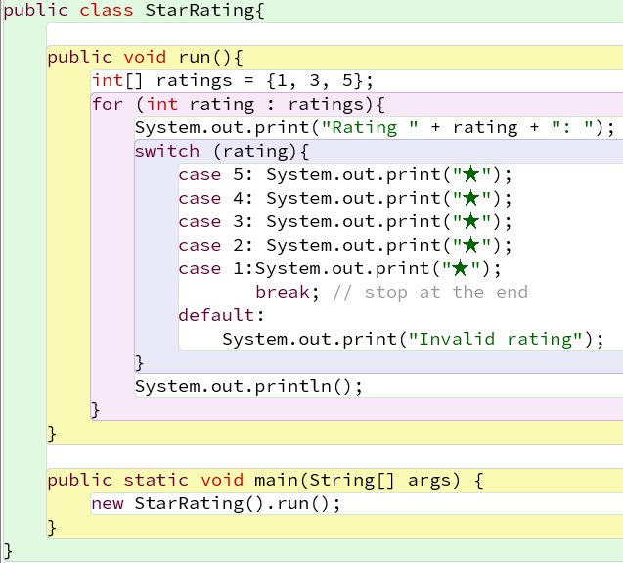
⭐Optional Challenge: Stars Without break
We want to display a rating using stars (★). Ratings range from 1 to 5.
This example deliberately uses fall-through: there are no break statements between the cases.
For example:
  rating = 3 → starts at case 3, then falls through case 2 and case 1 → ★★★
  rating = 5 → falls through all the cases → ★★★★★
The break at case 1 stops the switch.
💡Challenge: How would you write this using break after every case, while producing the same output? (See the accompanying project.)

Slide 41
Switch Case – Rules and Limitations
⚠️Important limitation:
switch cannot do comparisons like <, >, <=, >=.
It can only test equality (==) with allowed types.
💡 Rule of thumb:
Use switch to compare one value for equality among several constant options.
Use if-else for inequalities or ranges.
✅ Allowed types for case values:
Whole numbers (int-sized): byte, short, int (and wrappers)
Characters: char (e.g., 'A', 'b')
Strings: String (e.g., "yes", "Brighton")
Enums: enum constants (e.g., Colour.RED) - advanced, can ignore for now
❌ Not allowed:
long, float, double
boolean
Other object types (except String or enum)

Slide 42
Summary

Slide 43
Core Principles of Programming
We have now explored the three basic structures in programming, which are also known as the core principles of programming:
Sequence – instructions run one after another in order.
Selection – choosing which instructions to run.
Iteration – repeating instructions multiple times (loops).
💡 With just these three, you can build almost any program.
When learning a new language, a good first step is to ask: How does this language do sequence, selection, and iteration?

Slide 44
Key Ideas
Code blocks & curly brackets
  Nesting instructions
Enhanced for (for each) loop
  Arrays (a group of things)
  Variables (names for values)
If statements
  Test/condition expressions
  Else clauses
  Else - if chains
switch statements
  Special kind of if for multiple tests of the same value
break
  to end a switch or loop early

Slide 45
Key Ideas
Variables - boxes holding values we use or calculate
Enhanced for loops - repeat instructions over collections
If statements - making choices
Switch statements - compact multi-choice selection
break - special command to end a switch/loop in the middle
Keywords (for, if, else, switch, case, break) - reserved words in Java
Tests - conditions that can be true or false
Combining elements - curly brackets group instructions into structures

Slide 46
Lab Instructions - Enhanced For Loop & Choices
1️⃣ Download the project
Download the enhanceForChoices.zip project file and open it in BlueJ.
2️⃣ Explore the example classes
Open each of the example classes (double-click the class box) and view the code.
Try to understand what each one does (refer to the lecture slides if needed).
Compile and run each example to confirm your understanding.
Examples are named naturally (e.g., HelloWorld, HelloPlaces, HomeTown, EstateAgent).
3️⃣ Work on the exercises
Open the exercise classes, which are prefixed with Ex (e.g., Ex_HomeTown).
Follow the instructions at the top of each file to modify the code and implement the requested functionality.
Compile and run to test your changes.
4️⃣ Check solutions (optional)
Model answer classes are prefixed with Sol_… (e.g., Sol_HomeTown).
Only open or refer to them after attempting the exercises yourself to check your work.
5️⃣ 🚀Challenging exercise - Star Ratings (for experienced Students)
Modify the StarRating class to use two arrays
Print each hotel with its star rating using a switch statement without break statements.
👉Need help with BlueJ?
See the “Using BlueJ - A practical guide for Java programming” slides for step-by-step guidance on loading, compiling, running, and working with your Java projects.

Slide 47
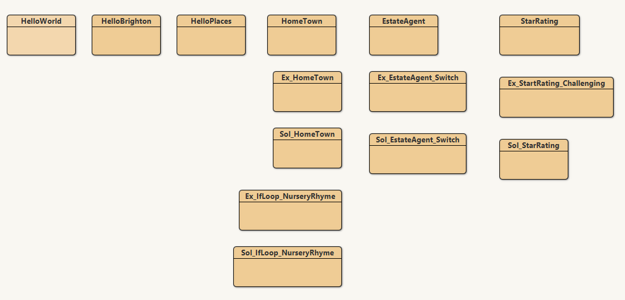
enhanceForChoices - BlueJ Project View
Screenshot included so you know what the project looks like when opened.
Tips: Drag class boxes to organize them; your view may look different.
Challenging Exercise
For Experienced Students

