Slide 1
CI401
Introduction to programming
Programming and Java: Additional Background and Getting Started
Notes:
Programming and Java: Additional Background and Setup

Slide 2
What This Set Covers
💻 Programming Basics
What is a program?
  A brief history of programming languages
  Source code compilation
  What is an IDE?
☕ Java: A Little More to Know
A brief history of Java
Core features
Java editions
Java architecture (JDK, JRE, JVM)
🦶Getting Ready for Java Programming
What we need: JDK and IDE
How the JDK and IDE work together
Installing BlueJ
Using another Java IDE

Slide 3
Programming Basics
Understanding Programs, Programming Languages, and Compliers

Slide 4
What is a Program?
📑A program (also called software or application) is a set of instructions that tells a computer what to do.
We use programs to interact with computers.
Programs are written so computers can understand them.
🤖Program instruction: “Add 2 + 3 and show the result”.
Computer processes it: Calculates the sum
Output: 5

Slide 5
Programming Languages
💻 Computers are machines:
❌ They cannot understand human languages
🤖 They only understand computer languages
📝 Programming Languages:
Languages that computers can understand
Used to write programs
🧑‍💻 Human → “Instruction in programming language” → Computer (🤖 understands it)
In short - We use programming languages to write programs and talk to computers

Slide 6
Three Levels of Programming Languages
Java, Python, C++, C,… | Use English, Human friendly. C=A+B
Assembly languages | Keywords introduced. ADD A, B MOVE VALUE 10 TO REGISTER A
Machine/Binary languages | Use 1s and 0s to create instructions. 10101011111110001
High Level Languages
Programming
Languages
Middle Level Languages
Low Level Languages

Slide 7
Low Level Languages
Also called Machine Language, Binary Language
A computer’s native language, written in zeros and ones (0 | 1)
Machine dependent - differs between different types of computers
Hard to use for humans
🤔10101011111110000011100001111 🤖

Slide 8
Middle Level Languages
Also called Assembly language
Machine dependent - still tied to specific computers
Introduces keywords like ADD, SUB
Makes programming easier than machine language
🖥️ADD X TO Y, MOVE VALUE 10 TO REGISTER A

Slide 9
High Level Languages
A new generation of programming languages
Use English words, easy to learn and use
Program written in a high-level language is called ‘source program’ or ‘source code’
Machine independent - runs on different computers
Instructions are called ‘statements’
🔄A compiler or interpreter is used to translate source code to machine code.
📑
print("Hello, World!");
x = 5 + 3;
print(x);

Slide 10
Complier
Translates or converts source code into machine code - This process is called compilation.
How a compiler works
📑 Source Code (Human-friendly) → 🔄 Compiler → 🤖 Machine Code (Computer-understandable) → 🖥️ Computer Runs It → ✅ Output
Don’t worry about the compiler - tools handle it for us; we focus on writing source code
Notes:
Source program → Executable
The source code is what we write (human-friendly)
The compiler translates it into machine code (Computer-understandable)
The computer executes the machine code to produce the output

Slide 11
IDE
An IDE (Integrated Development Environment) is a development tool that brings common programming activities together in one place.
An IDE helps us to:
✍️ Write - create and edit source code
🔄 Compile - translate source code into a form the computer can execute
🐞 Debug - find and investigate errors
🏗️ Build - prepare the program and project files for execution
▶️ Run - execute our program
📁 Organise source files and project resources
In short: An IDE lets us Write → Compile → Debug → Build → Run in one place, making programming more convenient.
Most programming languages have IDEs or development environments designed to support programming in that language.

Slide 12
Java: A Little More to Know

Slide 13
Getting to Know Java
Initiated by James Gosling, Mike Sheridan, and Patrick Naughton at Sun Microsystems started in 1991, released in 1995; acquired by Oracle in 2010.
Machine independent - “Write once, run anywhere”
High-level, general-purpose, object-oriented programming (OOP) language
Very popular and widely used

Slide 14
Three Editions of Java
Java Standard Edition (SE)
🖥️ Used to develop desktop applications
(👆this is what we will learn)
Java Enterprise Edition (EE / Jakarta EE since 2017)
🌐 Used to develop server-side applications
Java Micro Edition (ME)
📱 Used to develop mobile device applications

Slide 15
Java Architecture
JDK
🌏 How Java Runs Anywhere
JRE
JDK (Java Development Kit)
Toolkit for developers.
Includes the compiler (javac) + JRE.
JRE (Java Runtime Environment)
Environment for running Java programs.
Includes the JVM + standard libraries.
When we write Java programs, we often use these libraries (e.g., Scanner).
JVM (Java Virtual Machine)
The actual executor that runs Java programs.
Converts bytecode into machine code for computer.
JVM on each OS runs the same bytecode
→ platform-independent
JVM
👩‍💻 Write code
📑 Source Code (*.java)
JDK Compiler
📦 ByteCode (*.class)
JVM converts to
machine code
0️⃣1️⃣ Machine Code
🖥️ Runs on Any OS
(Windows / Mac / Linux)
💡 Don’t worry if this looks complex — the behind scene theory will not affect you write and run java program
Notes:
How it works together
You write code → JDK compiler creates bytecode.
JVM (inside the JRE) runs the bytecode.
The standard libraries from JRE are also used while the program runs.
✅ Your program works on any machine that has a JVM.
In short:
JDK → for writing & compiling.
JRE → for running.
JVM → the actual executor.
Libraries in JRE → what they use in real code.
Key Points
.java → human-readable source code
.class → machine-independent bytecode

Slide 16
Don’t Worry About the Architecture
You don’t need to fully understand JDK, JRE, or JVM to start writing Java programs.
Just know the basics:
  JDK → compiles your code into bytecode
  JVM → runs the bytecode on your computer
  The libraries in JRE provide ready-to-use tools (e.g., Scanner) automatically.
All the complicated stuff happens behind the scenes.
👉Focus on writing and running programs first.
Once you start coding, everything will make more sense naturally.

Slide 17
Getting Ready for Java Programming

Slide 18
JDK: Getting Started with Java
You already know that the JDK is essential for developing Java programs.
With a JDK, which can be downloaded from the Java website, we can:
write Java code in a plain text file
compile it using the Java compiler from the command line
run the resulting program from the command line
However, working this way can be inconvenient.
Even a simple program requires several separate steps when using the command line.
To simplify the workflow, we can use an IDE, which brings these activities together in one place.
Common Java IDEs include IntelliJ IDEA, BlueJ, Eclipse, VS Code, …...
🤔 So if the JDK provides the tools and an IDE makes them easier to use, how do they work together?

Slide 19
How JDK and IDE Work Together
🦶JDK = your feet
  Provides the power to move (compile and run Java programs)
  Provides the core tools that do the real work
  Provides the underlying Java development capabilities
👟IDE = your shoes
  Makes moving easier, more comfortable, and organized
  Offers helpful tools: code editor, compiler shortcuts, debugging, etc.
👩‍💻 You = the programmer
  Decide how to move (write programs)
  Can move with bare feet (JDK only) or choose different “shoes” (IDE)
  Either way, it’s always your feet (JDK) doing the work underneath
Note: Any IDE (usually developed by a third party) still relies on the JDK.

Slide 20
Preparing Your PC for Java Programming
To write and run Java programs, your PC needs:
a JDK
a Java IDE such as BlueJ, IntelliJ IDEA, or Eclipse
University PCs
The required software is already installed. You do not need to install anything yourself.
Your own PC
You may need to install both the JDK and an IDE.
Notes on IDEs
BlueJ 5.x includes a JDK in its installer, so a separate JDK installation is normally not required.
Other IDEs may require you to install a JDK separately or select an existing JDK when creating a project. The exact process depends on the IDE.
Who these instructions are for
These instructions are intended for students who are new to installing software. If you already know how to install software on your PC, you can skip the following slides.
The following slides cover:
installing a JDK, if required;
installing BlueJ step by step on Windows;
brief notes for students using macOS or another Java IDE.
👉If you have any difficulty with installation, please contact any module team member by email or speak to us in the lab.

Slide 21

Installing a JDK - If Required
👉The steps below are for Windows.
Different JDK versions may look slightly different, but the overall installation flow is very similar.
Go to the official Oracle JDK download page: https://www.oracle.com/java/technologies/downloads/
A common choice is the latest or latest Long-Term Support (LTS) Java SE Development Kit (JDK) for your operating system.
Download the installer (.exe for Windows).
Run the installer:
  Accept the license agreement
  Keep default settings
  Click Next until installation completes
Verify installation:
  Open Command Prompt
  Type: java -version or javac -version
  You should see the installed version numbers
  👇See note pane for notes for macOS users.
Notes:
Notes for macOS users
On macOS, it depends on your Mac’s processor:
🖥️ Older Intel‑based Macs (before ~2020) → download the x64 (Intel) version.
💻 Newer Apple Silicon Macs (M1, M2, M3, …) → download the ARM / AArch64 version.
In general: use the ARM version unless you have an older Intel Mac.

Slide 22

Overview - Install BlueJ
Go to the official BlueJ website: https://www.bluej.org/
Click Download and choose your operating system (Windows / macOS / Linux).
Download the installer and run it:
  Accept license agreement
  Keep default installation settings unless you have a specific reason to change them
  Click Next until installation completes
👏 Open BlueJ after installation and try your first program (HelloWorld).
👉Need more detailed help?
See the following step‑by‑step installation guide for screenshots and additional notes.
Example shown: BlueJ 5.5.0 on Windows.
Steps are very similar across versions. Short notes for macOS appear at the end.

Slide 23
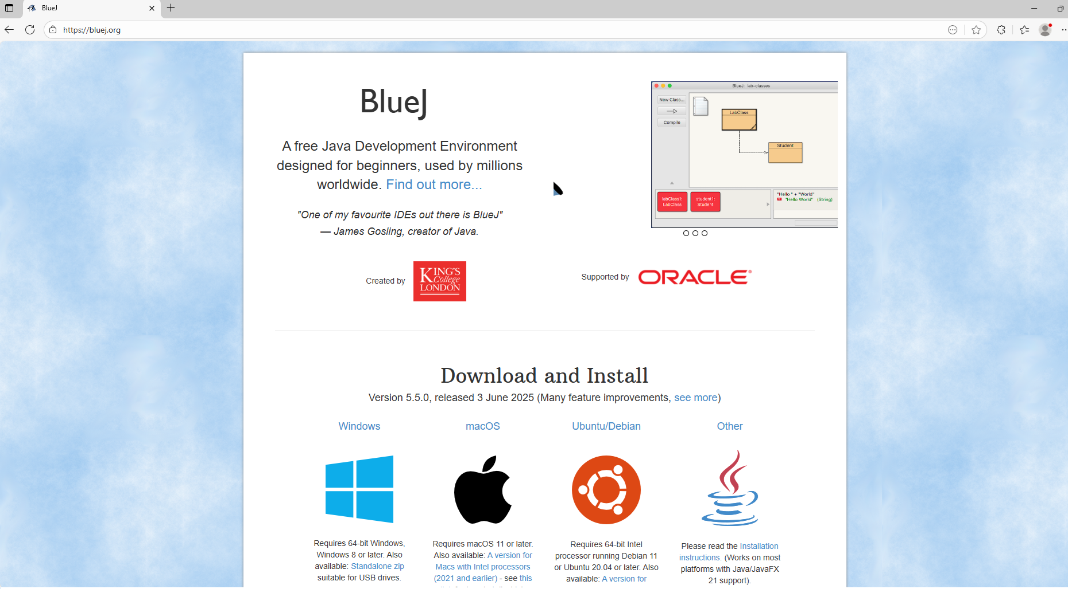
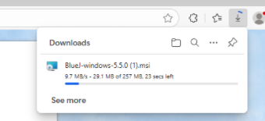
Download BlueJ
Open your browser and Type in ‘bluej.org’.
Select the Windows installer (or your own operating system, but the remaining steps might be a bit different); and wait for the downloading to finish

Slide 24
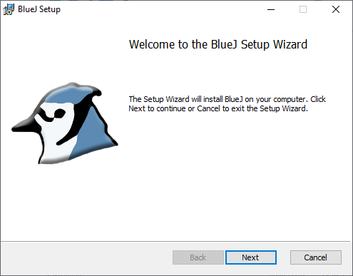
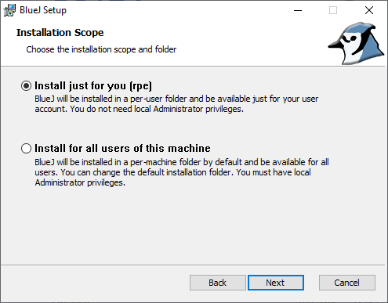
Run the Installer
Double-click the downloaded file to start. If Windows warns you, choose More info → Run anyway (if you trust the source).
Click ‘Next’
Accept the licence.
Choose Install for “Just me” (recommended on personal PCs).

Slide 25
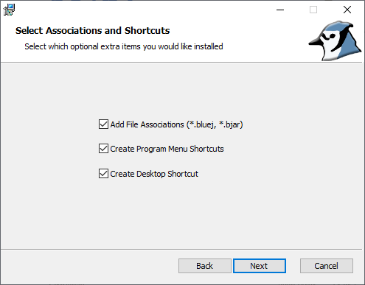
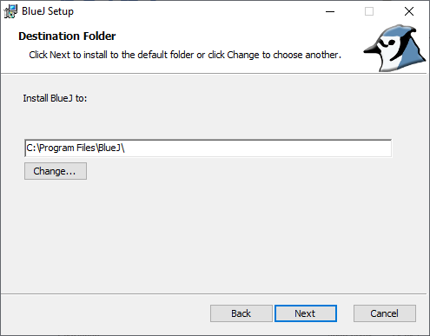
Follow the Setup Wizard
Leave checked: Create Start menu/desktop shortcut and Associate .bluej files.
Keep defaults for the install location unless you have a reason to change it.

Slide 26
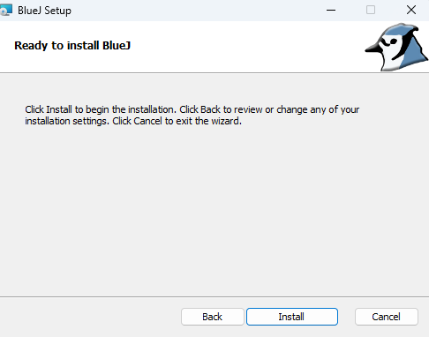
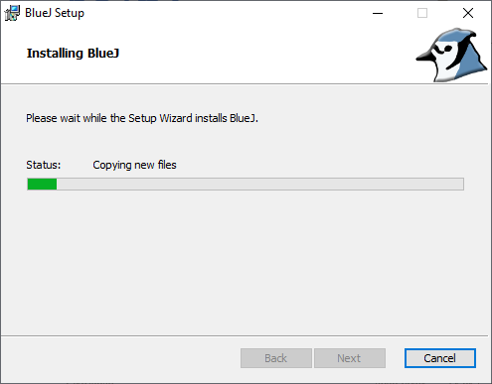
Install → Finish
Click Install (The system may ask you to confirm the installation. Say ‘Yes’)
Wait for the installation to complete

Slide 27
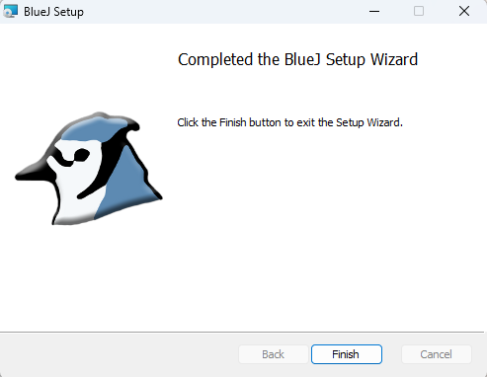
Finish
Click ‘Finish’ to exit form the installer

Slide 28

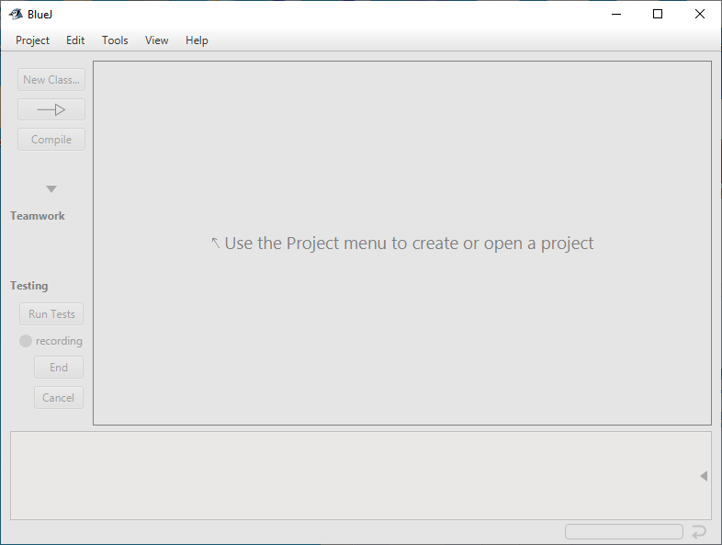
Launch BlueJ
There should be a Bluej shortcut on your desktop - double click on it to start Bluej (Or open from Start → BlueJ)
BlueJ will start up with an empty “Project” window.
Now you’re ready to start coding!

Slide 29
Try Your First Program in BlueJ
1️⃣ Create a new project
  Click Project → New Project
  Name it (e.g., myProject) and choose a location → click OK
2️⃣ Create a new class
  Click New Class
  Name it HelloWorld → choose Class → click OK
3️⃣ Write your code
Double-click the HelloWorld class box
In the editor, copy the code below:
4️⃣ Compile the class
Click Compile in the editor
5️⃣ Run the program
Right-click the HelloWorld class box
Select void main(String[] args) → click OK
🎉 Congratulations!
You should see: Hello, World!
public class HelloWorld {
public static void main(String[] args) {
System.out.println("Hello, World!");
}
}

Slide 30
Working with Java projects in BlueJ
See the “Using BlueJ - A practical guide for Java programming ” slides for step-by-step guidance on:
Opening a provided project ZIP
Compiling and running programs
Checking program output

Slide 31
Notes for Other OS and IDE Users

Slide 32
Using BlueJ on macOS
Download BlueJ
  From the official BlueJ website, download the macOS .dmg installer.
Install
  Open the .dmg.
  Drag BlueJ.app to Applications, or, if a .pkg installer is provided, run it and follow the prompts.
First launch
  Start BlueJ from Applications.
  If macOS prevents it from opening, Control-click → Open → Open to approve it.
Try your first program
Follow the steps in “Try Your First Program in BlueJ”.
The screens may look slightly different from Windows, but the basic workflow is the same.
Note: Installation steps may vary slightly between BlueJ and macOS versions. The overall process is similar.

Slide 33
Other IDE Users
If you prefer to use IntelliJ IDEA, Eclipse or VS Code, the overall Java programming workflow is the same, but the project setup is different.
JDK
  These IDEs may require you to install or select a JDK when setting up a project.
  If you need to install a JDK, see “Installing a JDK - If Required” for guidance.
IntelliJ IDEA
  New Project → Java → select a JDK.
  If no JDK is listed, use Download JDK or Add JDK and select your installed JDK.
Eclipse
  Window → Preferences → Java → Installed JREs → Add… (Standard VM)
  Select your JDK installation.
VS Code
  Install the Extension Pack for Java.
  When prompted, install or select a JDK (or set JAVA_HOME to your JDK).
Using provided material
  Open the provided projects, then copy the code into your IDE project.
  The Java code is identical across IDEs; the project setup and user interface may differ.
  Note: Menu names and setup steps may vary slightly between IDE versions. The main workflow remains the same.

Slide 34
Summary
You now have the background and practical guidance to begin programming in Java.
You have explored basic programming concepts and how source code is compiled.
You have learned a little more about Java, including the JDK, JRE, JVM and IDEs.
You have guidance for preparing your PC, installing BlueJ and running your first program.
When you are ready, continue with the practical work in the main module materials and labs.

