Slide 1
CI401
Introduction to programming
Using BlueJ - A practical guide for Java programming
(Loading, compiling, running, and working with your Java projects)
Notes:
Extra Reading Available

Slide 2
How to Use This Slide Set
This slide set will show you how to load exercises into BlueJ and perform basic operations, such as opening, compiling, running, checking program output, and duplicating a class when needed.
Here, we use the Week 1 enhanceForChoices project and HelloWorld program as examples. Each week, you’ll receive a different project to work with.
💡This section is about using BlueJ as a programming tool, rather than learning Java itself.
Note for other IDE users:
You can still follow along - simply open the provided zipped project code and copy it into your preferred IDE to compile and run.

Slide 3
Extra Reading Available
Later in this slide set, you will find an optional section: “Extra Reading - Code Essentials”.
It’s not required right now. Treat it as a reference as you start writing Java code.
It explains some useful basics, such as punctuation, brackets, code layout and colour.
It highlights what matters to Java and what mainly helps us read the code.
💡You do not need to remember all the rules at this stage. We will learn Java syntax gradually as you write more programs.
You can return to this section when you encounter these features in your own programs.
👉For many beginners, even a small program can feel overwhelming - almost every word, symbol and line may raise a question. This is normal. You do not need to understand everything yet; focus on what we are learning at each stage, and your understanding will build gradually.

Slide 4
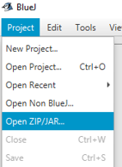

Launching BlueJ and Loading Your First Project
Start BlueJ
Run BlueJ from the Windows Start menu like any other app.
Tip: If you did not see it, type “BlueJ” into the search bar.
BlueJ First Look - When BlueJ starts for the first time, it will be empty (a grey, empty shell), waiting for you to create or load a project.
1️⃣ Download the project
Download a BlueJ project (zip file) from weekly study materials on MyStudies. Example: enhanceForChoices.zip in week 1
2️⃣ Open the project in BlueJ
  In BlueJ, go to Project → Open ZIP/JAR…
  Browse to the zip file you downloaded, select and open it
BlueJ will automatically extract the project and create a project folder with the same name as the ZIP file, in the same location.
The project is now ready to open and work with in BlueJ.

Slide 5
📌Extra Notes – Your Work Lives in the Unzipped Folder
All your work happens in the unzipped folder. BlueJ does not modify the original ZIP file.
Editing, compiling, running and saving - everything happens in the unzipped project folder, such as enhanceForChoices.
💡 Tip: When sharing your work, remember to provide the unzipped project folder. Treat the original ZIP file as a backup.

Slide 6
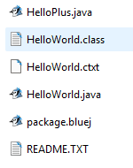
Opening and Reopening Projects in BlueJ
When you start BlueJ, it will automatically open the latest project you worked on.
To open a new zipped project, follow the steps we already showed:
Project → Open ZIP/JAR… → browse to the zip → open it.
👉To open a previous (existing) project folder:
  In BlueJ, select Project → Open Project…, browse to the unzipped project folder, and click Open.
  Or, go to the folder on your computer, find the file named package.bluej (or package), and double-click it. BlueJ will start with that project.
Remember: BlueJ always works in the unzipped folder, never the zip file.

Slide 7
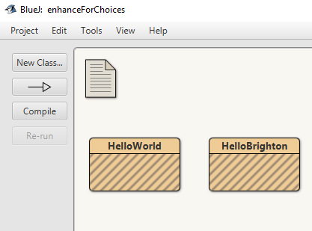


BlueJ’s Class Explorer view
When you open a project in BlueJ, you will see several yellow boxes.
Each yellow box represents a class - a small program or part of your project.
The name on a yellow box is the same as the class name (see next page).
Sometimes, you may also see purple boxes representing project navigation.
Aside: purple boxes
<Go up> : double-click to move up one level in the project.
A purple box with a name : double-click to open that package and reveal the classes inside.
The boxes you see depend on the project structure. You do not need to worry about this for now, as our projects are simple and usually do not contain purple boxes.
💡 Tip: You can click and drag class boxes to arrange them in the Class Explorer.
We’re now ready to practise the basic steps for working with a class, using HelloWorld as an example: opening, editing, compiling and running it. The same workflow applies to other classes, although the program and its output may be different.

Slide 8

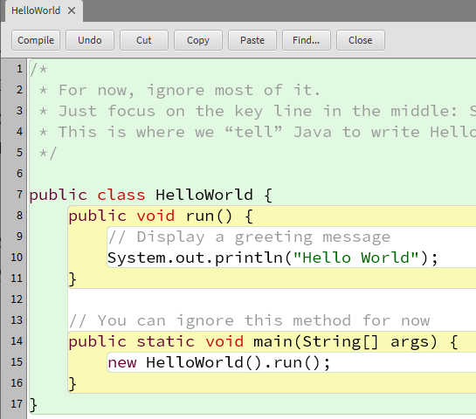
Opening Your First Java Program HelloWorld
Double-click the yellow HelloWorld box.
A new editor window will appear with some coloured text inside. This is a Java program.
All it does is tell the computer to display: Hello World
Traditionally, this is the first program you encounter in any programming language.

Slide 9
Getting HelloWorld to Work
When the computer carries out the instructions in a program, we say that the program is running.
To run a Java program, there are two steps:
Compile - Convert the Java code we write in a .java file into bytecode, which the Java Virtual Machine (JVM) can run.
Run (Execute) - Tell the computer to carry out the compiled instructions.

Slide 10
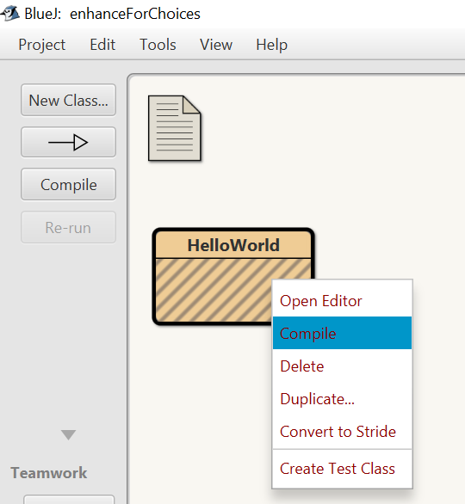
Compiling HelloWorld
To compile your HelloWorld program:
Using the Explorer View: Right-click on the HelloWorld class box and select Compile.
Or, using the Editor Window: Click the Compile button.

Slide 11
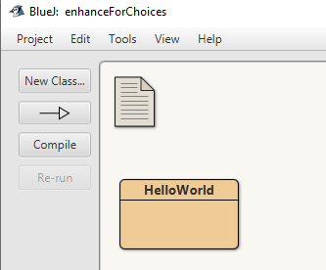
HelloWorld Compiled
The yellow box loses its shading to show it has been compiled
💡 Takeaway: You can use the Compile button on the left to compile all the yellow boxes in the Class Explorer in one go.
Compiled

Slide 12
Running HelloWorld
Once your program is successfully compiled, it’s ready to run.
BlueJ offers two ways to execute your code:
1️⃣ Run via the main method Right-click on the HelloWorld class box. Select void main(String[] args). Click OK to run the program. 💡 key point: The main method is the starting point of any Java program. | 2️⃣ Run via a class instance Right-click on the HelloWorld class box in the Explorer view. Select new HelloWorld() to create an instance of the class. A small red object icon appears. Right-click it, then choose the method you want to run (for example, here is run()).
🔽See the next few pages for step-by-step instructions on running HelloWorld.

Slide 13
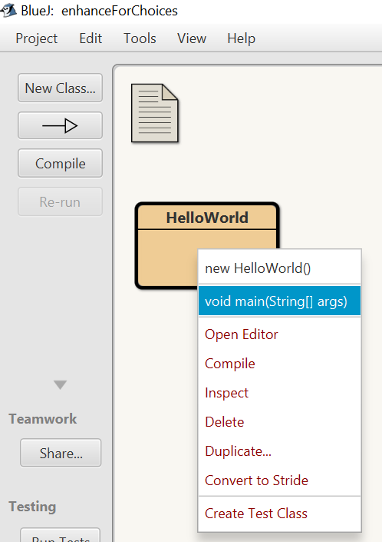
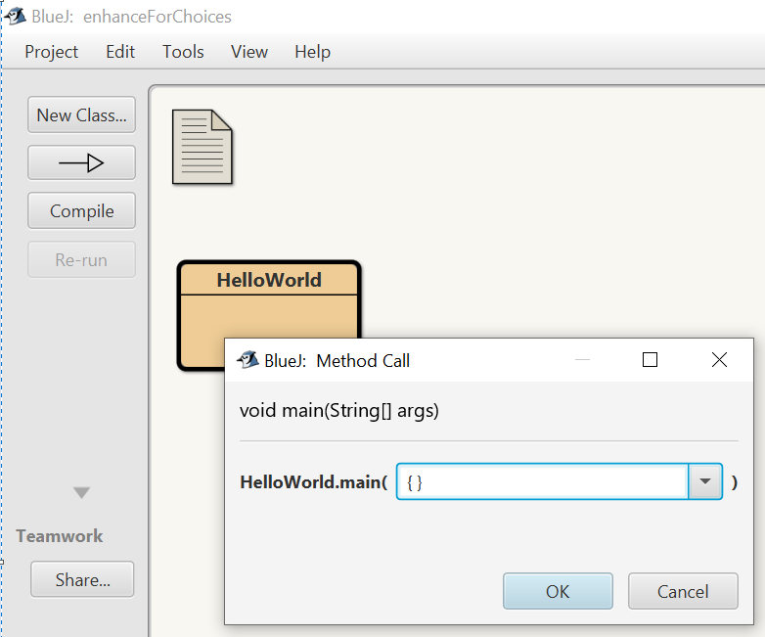
1️⃣ Run via the Main Method
Step 1: Right click HelloWorld - the menu now has two new options at the top Select the second one void main(String[] args) | Step 2: A dialog box appears. Just click OK. The program will run. 💡Takeaway: This is the standard way to run a Java program. The main method is always the entry point.

Slide 14
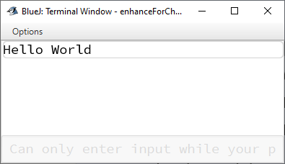
1️⃣ Run via the Main Method - Check Result
A new window appears - BlueJ calls it the Terminal Window. This window shows the output of your program.
Since our program tells the computer to display text, you’ll see: Hello World
🎉Job done, your first Java program has run successfully!

Slide 15
2️⃣ Run via a Class Instance
Step 1: Right click HelloWorld after compiling it, Select the top one – new HelloWorld() | Step 2: Name the Instance A box pops up to give the instance a name We don’t care what the name is (but you can change it if you want) so just click OK – this will create an instance of HelloWorld

Slide 16
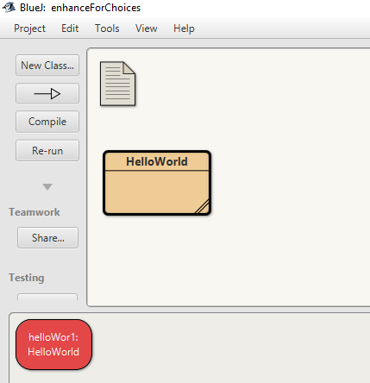
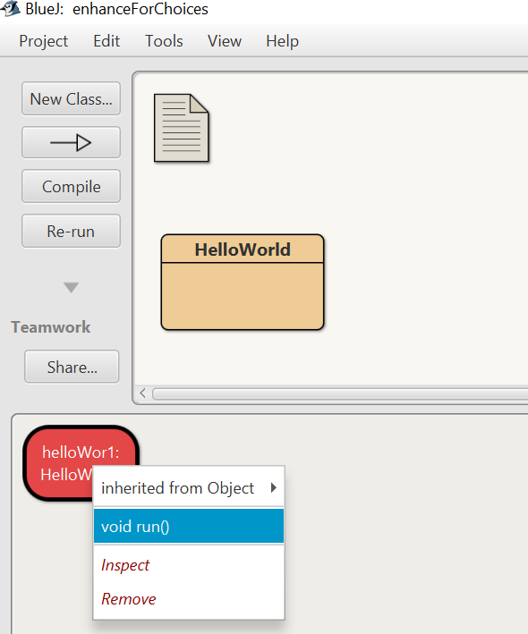
2️⃣(con)Run via a Class Instance
Step 3: HelloWorld instance created A new red box appears in the bottom left This is the HelloWorld instance we have just created | Step 4: Right click on the red instance Select the second option void run() The program will run, and you will see the same output as when running via main method: Hello World was written in the terminal window.

Slide 17
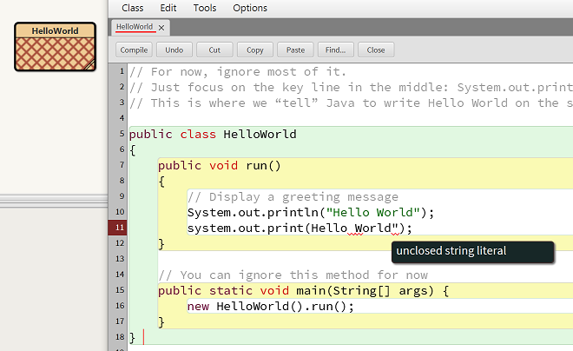
Editing Your Program
You can edit the Java code when you need to change or extend the program.
After making changes, compile the class again before running it.
If there are errors in your code, BlueJ will highlight them.
The class box will show red cross-hatches when the class contains compilation errors.
Fix the errors and compile again.
Once the program compiles successfully, you can run it as before.
💡 Remember: Errors are not failures - they are a normal part of learning to program.

Slide 18
Duplicating Classes
Sometimes you may want to experiment with your code while keeping the original version unchanged. Duplicating a class gives you a separate copy to work with.
1. Right-click the class and select Duplicate….
2. Rename the new class:
  Choose a meaningful name, as you may create several versions.
  Start the name with a capital letter, e.g. HelloExperiment.
3. Double-click the new class to open and edit it.
➡️ ➡️
💡 Takeaway: You can also right-click an empty area in the Class Explorer and select New Class, but BlueJ may add template code that you do not need. Duplicating an existing class keeps the structure you already need.

Slide 19
Workflow Summary
Open project → Open class → Compile → Run
→ Edit → Compile again if necessary
→ Duplicate when useful

Slide 20
Extra Reading – Code Essentials

Slide 21
What’s Important in Java Programming
📌This section will help you:
understand what is essential when writing Java programs;
recognise what is mostly for your convenience;
avoid common beginner mistakes;
become familiar with important details of Java syntax
👉Key ideas
Program instructions must be precise - spelling, punctuation and balanced brackets matter.
Code layout and colour are mainly for us. The computer does not rely on spaces, indentation or colour in the same way we do, but clear formatting makes code easier to read.
Use comments to make notes, explain your code, or leave reminders for yourself.

Slide 22
What Matters & What Doesn’t in Java
What Matters: Semicolons, commas, full stops → vital. Brackets & quotes must balance. Case sensitivity is strict. Programming demands exact spelling and punctuation - No “close enough”! | What Doesn’t Matter: Colours, layout, spaces are just helpers. The computer ignores them (mostly). Comments are ignored by Java but help humans a lot.

Slide 23
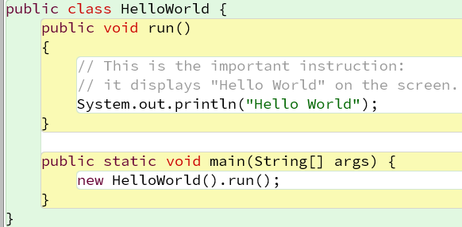
Punctuation Matters
Semi-colons, commas and full-stops are important.
Brackets and quotes must balance - {…} (…) […] “…”
But they can be ‘nested’ inside each other – { { … } } [ ( … ) ]
It’s not like ordinary sentences!

Slide 24
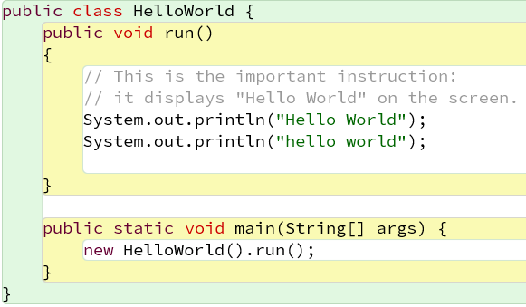
Capital Letters and Spelling Matter
'HelloWorld', 'helloworld', and 'hello world' are all different identifiers.
'System' ≠ 'system’ - Java is case-sensitive.
'println' must be spelled exactly like this (short for “print line”).

Slide 25
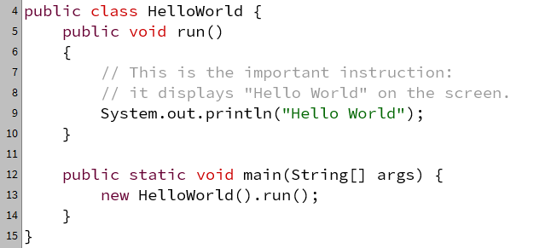
Colour Does Not Matter
Colour doesn’t matter to Java
It is just IDE (BlueJ, Eclipse, or IntelliJ etc) helping to make it easier to read.

Slide 26
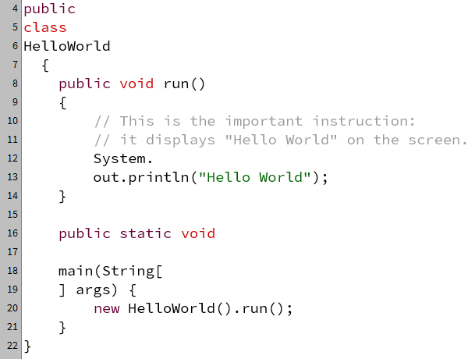
Layout Does Not Matter(much)
Layout (spaces, line breaks) mostly doesn’t matter
As long as you don’t break
  words
  messages (in quotes)
  comments
But good layout helps humans understand your code!
(NB: Layout does matter in Python!)

Slide 27
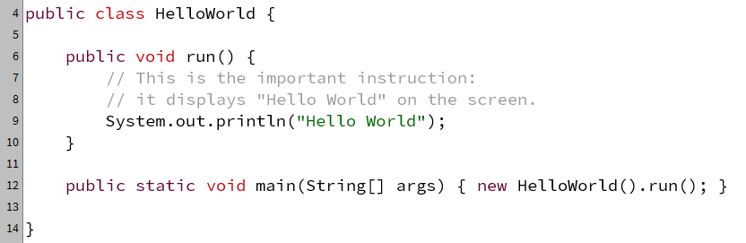
‘Unusual’ Layout Does Not Matter
Sometimes, unusual layout is fine.
Such as putting a small part of the program all on one line

Slide 28
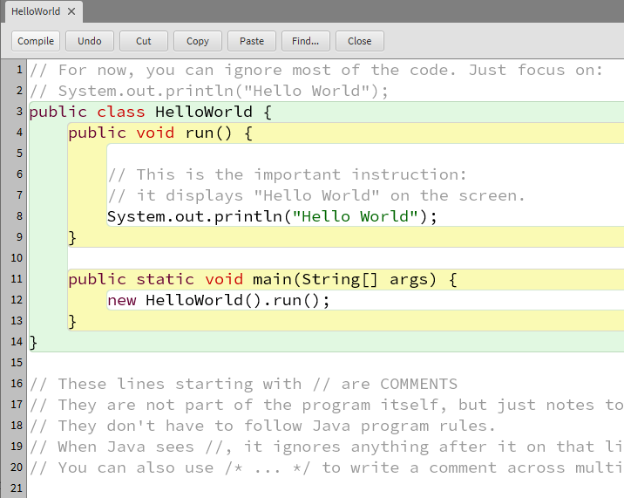
Using comments
Comments are notes for humans, not the computer.
Whenever Java sees two (forward) slashes, the rest of the line is a comment - Java ignores them completely when running your program.
You can use comments to:
Give information (e.g., author, version, date).
Explain what the code does.
Temporarily “comment out” code you don’t want Java to run

Slide 29
You Will Learn These Gradually
You are not expected to remember or understand all of this yet.
We will learn Java syntax and programming details step by step throughout the semester.
As you write more code, you will see the same patterns again and again, and they will become more familiar.
🌱 For now, just be aware of what Java cares about and what mainly helps us read and organise our code.

