Slide 1
CI401
Introduction to programming
Input and Repetition: Scanner + While Loop
Notes:
Talk to programs

Slide 2
Learning Outcomes
Input and output
  Understand input and output in programming
  Use Java Scanner to read input
While loops
  Write while loops with clear loop conditions.
  Control loop variables to avoid infinite loops.
Apply all features learned so far to create interactive programs.

Slide 3
IO: Input and Output
Communicating with your program
Notes:
Talk to programs

Slide 4
Input and Output
Programs are not very useful if they cannot communicate with the outside world.
This communication involves input and output (I/O).
Input - information provided to the program from outside (e.g. from the keyboard, mouse, touch screen, a file, or another program).
Output - information the program sends out (e.g. to the screen, a file, or another program).
A simple IO diagram:
💡Why it matters
Without input, programs always do the same thing. With input, you can make programs that are interactive and dynamic.
Input
Program
Output
Notes:
Input - information coming into the program
Output - information sent out from the program
Example diagram:
Input - - - > [ Program ] - - - > Output

Slide 5
Human IO
Input to humans: senses (sight, hearing, touch, taste, smell)
Output from humans: talking, facial expressions, movement, writing, singing
In conversation: one person’s output = the other’s input
Notes:
A simple human version of IO is talking - if you hear someone talking to you it is input (to you), and if you talk it is output (by you)
Of course we have other ways of getting input, such as seeing. In fact the human senses (sight, hearing, touch, taste, smell) are all different kinds of input to a human
And as well as talking, we can change our appearance (eg smile), move etc, as well as higher level output like writing, drawing or making music
And in conversations, input and output go in both directions between participants - output by you is input for me and vice versa.

Slide 6
IO in Programs
Programs also have input and output channels
Simplest form: one input, one output (numbers, text, etc.)
Communication partners:
  Human users (via devices)
  Other programs
  The internet
  Specialised hardware (e.g. robots)
Devices = keyboard, mouse, screen … but we often think of them as “us”

Slide 7
IO in Java
Java provides two basic channels:
  System.in - input (keyboard)
  System.out - output (screen)
We’ve already used System.out.println(...) to print out messages on the screen
System.in
Java program
System.out
Today
Use System.in to get input from the user (keyboard)
Use Java’s built- in Scanner class to read input

Slide 8
Scanner

Slide 9
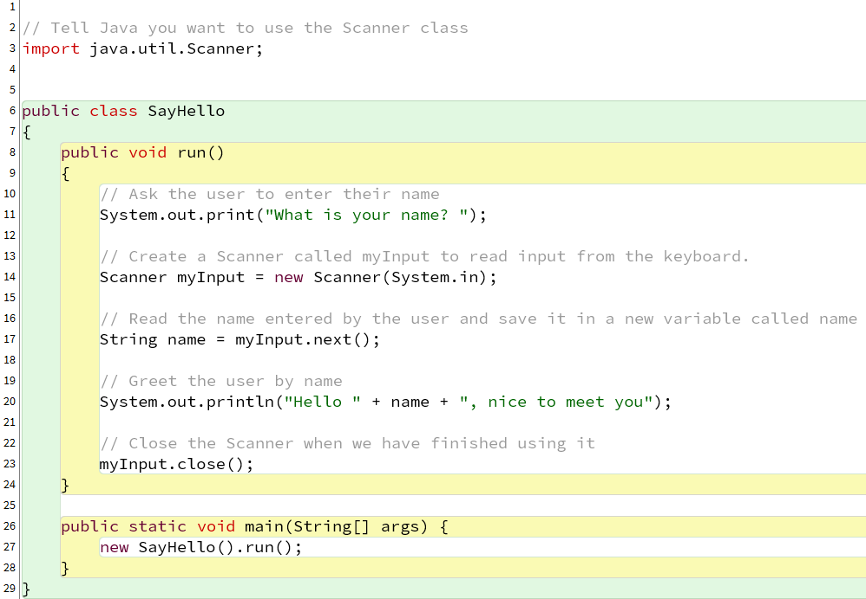
Scanner Example 1: SayHello
Scanner is a Java class that makes it easy to get input from the user.
This example program, SayHello, asks the user for their name and then greets them.

Slide 10
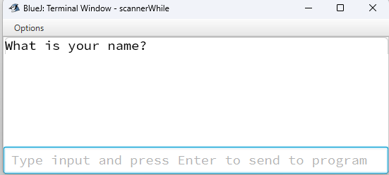
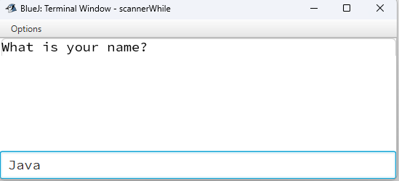
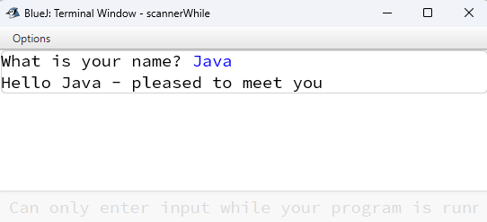
Running SayHello
First it prints a message (we call this a prompt) to ask me to type something
It uses Java’s output window, but notice the line at the bottom where I can type input as well
I type “Java” and when I press <enter> it gets sent to the program
The program responds by greeting Java!
Input area

Slide 11
SayHello: How Scanner works
We need to do several things to use Scanner:
import tell Java we want to use the Scanner class
  Print the prompt string (use print instead of println, so the input text ends up on the same line as the prompt)
Create a new variable called myInput which holds a Scanner which uses System.in to get its data
Use the method next() on myInput when it wants something from the user - whatever they type is put into the variable name
  print a message which includes the variable name (use println this time)
Close the Scanner object at the end

Slide 12

SayHello: variables again!
Just as a reminder, we are using two variables here
Line 14 declares a variable called myInput which can hold a Scanner, and then initialises by making a new Scanner object
Line 17 declares name which can hold Strings, and initialises it by asking the Scanner in myInput (the one we just made) to get a String from the user

Slide 13
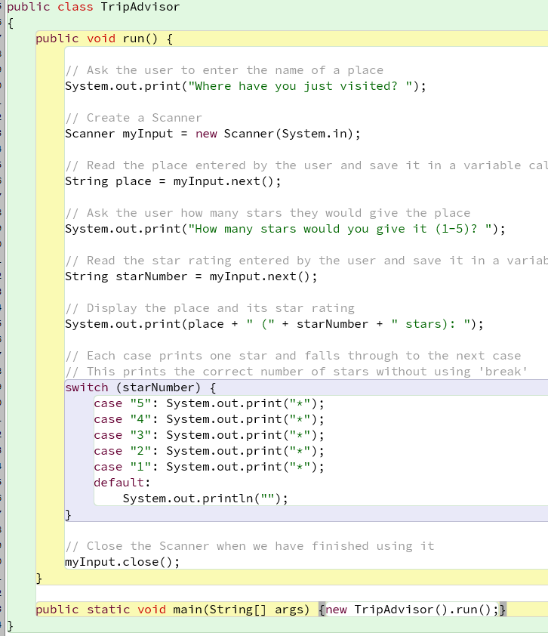
Scanner Example 2: TripAdvisor with StarRating
We revisit StarRating, but this time we ask the user for the input instead of using a predefined list.
Input from the user:
  Place visited → String place = myInput.next();
  Number of stars → String starNumber = myInput.next();
Output:
  Prints the place name and its star rating using a switch statement.
  Each case falls through (no break) so multiple stars are printed automatically.
Key difference from last version:
  Last time, ratings were hard- coded in an array.
  Now, ratings are interactive, making the program more dynamic and user- friendly.
💡Takeaway: Combining Scanner with a switch lets users control program behaviour, rather than relying on fixed data.

Slide 14
Common uses of Scanner
(slightly advanced)
Once you have a Scanner object (e.g., myInput), you can read different kinds of input:
myInput.next() Reads a single word (token) (up to a space or <Enter>); Example: String word = myInput.next(); Note: usually a word; digits are returned as a String, not a number. | myInput.nextLine() Reads a full line of text, including spaces; Example: String line = myInput.nextLine(); Useful when you want the full line text the user types
myInput.nextInt() Reads a whole number Example: int age = myInput.nextInt(); Useful for math operations with integers | myInput.nextDouble(); Reads a decimal number Example: double price = myInput.nextDouble(); Useful for math operations with decimals

Slide 15
Scanner Cheat Sheet
(For Future Reference)
Most commonly used: next(), nextLine(), nextInt(), nextDouble()
Method | Returns / Type | Example
next() | String (next token) | String word = myInput.next();
nextLine() | String (rest of line) | String line = myInput.nextLine();
nextInt() | int | int age = myInput.nextInt();
nextDouble() | double | double price = myInput.nextDouble();
nextFloat() | float | float rating = myInput.nextFloat();
nextLong() | long | long distance = myInput.nextLong();
nextBoolean() | boolean | boolean answer = myInput.nextBoolean();
nextByte() | byte | byte code = myInput.nextByte();
nextShort() | short | short smallNum = myInput.nextShort();

Slide 16
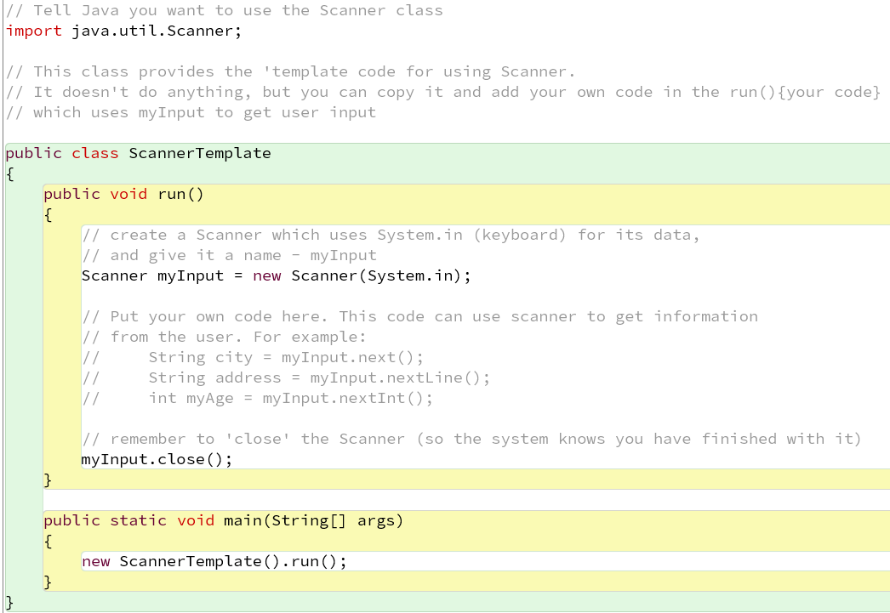
Using Scanner : a Template for You
This week’s lab material includes a class called ScannerTemplate
ScannerTemplate has the basic code you need to use a Scanner object
You can duplicate this class (see slides below) to make new programs that use Scanner

Slide 17
While Loop

Slide 18
While Loop
We have seen enhanced for loops: they run the loop body once for each item in a list.
While loops are different:
They do not need a list of items.
They use a condition (like an if statement).
How it works:
As long as the condition is true, the loop body runs again.
When the condition becomes false, the loop stops.
💡Tip: Think of a while loop as: “Keep doing this while the condition is true.”

Slide 19
While Loop in Java
false
condition
(test)
Used to run a block of code as long as a specified condition is true.
Syntax:
true
while (condition) {
// loop body
}
while loop body
code afterwhile loop
Read as: “While the condition is true, run the body again.”
Note: Structure is similar to an if statement - just replace if with while.
💡Important: Always make sure the condition can eventually become false, or the loop will run forever.
Notes:
To stop a loop:
Make the test depend on a variable (the loop variable).
Make sure the loop body changes the variable, so the condition can eventually become false.
Two common ways to update the loop variable:
User input (e.g., asking the user for a new value each iteration)
Calculation (e.g., incrementing or decrementing a counter)
💡 Tip: Always check that your loop has a way to stop before running it.

Slide 20
While Loop: Making Sure It Stops
The condition in a while loop is checked every time the loop runs.
The code of the condition stays the same, but the value(s) it checks can change → this allows the loop to stop.
If values don’t change, the loop body will keep running forever→ infinite loop!
To stop a loop:
  Make the test depend on a variable (the loop variable).
  Make sure the loop body changes the variable, so the condition can eventually become false.
Two common ways to update the loop variable:
  User input (e.g., asking the user for a new value each iteration)
  Calculation (e.g., incrementing or decrementing a counter)
💡Tip: Always check that your loop has a way to stop before running it.

Slide 21
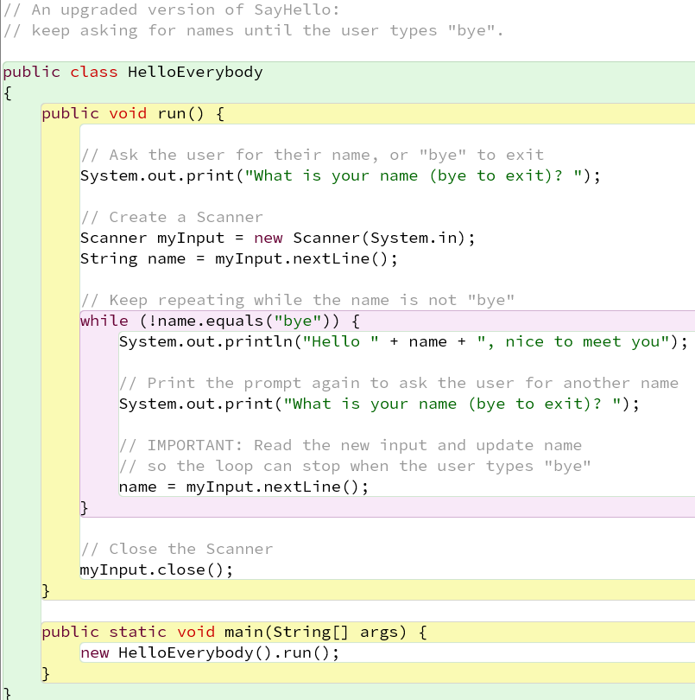
While Loop Example 1: HelloEverybody
HelloEverybody adds a while loop to SayHello
It uses a while loop to keep asking for names until the name given is the word “bye”.
It starts the same way, as SayHello, printing a prompt string and reading the first answer into the variable name
Then it goes into the while loop, where name is the loop variable

Slide 22
HelloEverybody: Stopping with User Input
The loop test (!name.equals("bye")) checks if name equals “bye" → this uses the loop variable.
The ! symbol means “not” → the test is true while name is not equal to “bye".
Prints the hello message using the current value of name.
Updates the loop variable → asks the user for another name and stores it in name.
The loop continues until the user types “bye" → then the test becomes false, and the loop stops.
💡 Key idea: Always update the loop variable inside the loop, or it may never stop.

Slide 23
✨Challenge: Special Responses to Certain Names
In HelloEverybody, everyone receives the same greeting.
Your challenge: Make the program respond differently to certain names.
If the name is Tom, ask: “Do you also have a friend called Jerry?”
If the name is Harry, ask: “How is Ron doing?”
For everyone else, keep the original greeting.
💡 Hint: Can you combine a while loop with if-else (switch-case)?

Slide 24
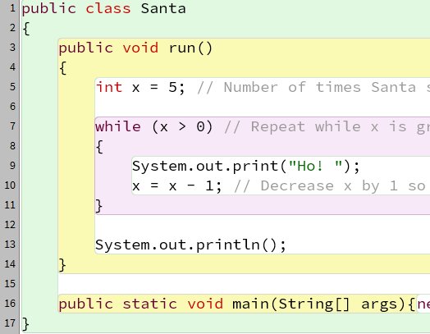
While Loop Example : Santa (Stopping with a Calculation)
Loops based on calculation are often simpler.
Example: the Santa class prints
Ho! Ho! Ho! Ho! Ho!
How it works:
  Loop variable: x (an int)
  Before the loop: set x = 5 (line 5)
  Check condition: x > 0 → loop stops when x reaches 0 (line 6)
  Loop body:
    Print "Ho!"
    Decrease x by 1 (line 10)
💡Key idea: A calculation- based loop uses a counter variable that moves toward the stopping condition.

Slide 25
Santa(Detail)
Using an int loop variable - can do calculations (x - 1) and checks condition (x > 0) with it
Line 10: x = x - 1;
  Looks like an equation, but is really an instruction:
  “Take the value in x, subtract 1, and store the result back in x.”
Shortcut operators:
  x- - → decrement (subtract 1)
  x++ → increment (add 1)
Output detail:
  print keeps things on the same line
  println moves to a new line (useful after the loop finishes)
💡Tip: Counters (x++, x- - ) are the most common way to control calculation- based loops.

Slide 26
While Loop Notes
Input- based while loops → unpredictable (because they depend on what the user types).
Calculation- based while loops → predictable (always run the same way).
General rule:
  Code is predictable unless it uses something from outside (e.g., user input).
You can also combine input and calculation:
  e.g., a calculation loop that runs based on a value the user provides (see Exercise DrawSquare).
Java also provides a random number generator, which adds unpredictability even without user input.
💡 Key idea: Loops can be deterministic (calculation) or non- deterministic (input, randomness).

Slide 27
✨Challenge Just for Fun: Tell Santa Saying Ho!🎅
The current Santa program prints “Ho!” a fixed number of times.
Your challenge:
1. Let the user choose: Ask the user how many times Santa should say “Ho!”, instead of using a fixed number.
2. Repeat the question: Keep asking the user how many times Santa should say “Ho!” until the user enters 0 or a negative number.
Hint: Use two while loops. One updates the loop variable using user input; the other updates it through calculation, based on the number entered by the user.
👉 Don’t worry if it feels hard - this is just a fun challenge to stretch your coding muscles!
🤔Curious how to do it? See the notes page for a code example.
Notes:
public class Santa1 {
public void run() {
System.out.print("How many Hos do you want to Santa to say? ");
Scanner myInput = new Scanner(System.in);
int number = myInput.nextInt();
while(number>0){
System.out.print("Ho! ");
number=number-1;
}
}
public static void main(String[] args) {
new Santa1().run();
}
}
--------------------
public class Santa2 {
public void run() {
System.out.print("How many Hos do you want to Santa to say (0 exit)? ");
Scanner myInput = new Scanner(System.in);
int number = myInput.nextInt();
while(number!=0){
while(number>0){
System.out.print("Ho! ");
number=number-1;
}
System.out.println("");
System.out.print("How many Hos do you want to Santa to say (0 exit)? ");
number = myInput.nextInt();
}
}
public static void main(String[] args) {
new Santa2().run();
}
}

Slide 28
Summary

Slide 29
Key Ideas
Scanner allows user input, making programs interactive.
Programs without input always behave the same way.
Input makes programs more interesting and useful.
While loops let us repeat code, controlled by:
  User input
  Calculations
  Random numbers
Lab exercises combined these techniques to make simple programs more exciting.

Slide 30
Summary - Input, Output, and While Loops
⌨️ 💻 I/O:
Human I/O - senses, talking, writing
Computer I/O - devices as intermediaries
IO in Java:
  System.out → messages on screen
  System.in → input from keyboard
  Scanner class for reading input:
    next() → get single word
    nextInt() → get whole number
    nextDouble() → get decimal number
    nextLine() → get a full line of text
🔄While Loops:
Repeat a block of code while a condition is true
Loop variables control when the loop stops
Int variables are common for calculation- based loops
Use ! for not in conditions
x++ and x- - are increment/decrement operators

Slide 31
Lab Instructions - IO & While Loop
1️⃣ Download the Project
Download the scannerWhile.zip project file and open it in BlueJ.
2️⃣ Explore the Example Classes
Open each of the example classes and read through the code.
Try to understand what each one does (refer to the lecture slides if needed).
Examples are named naturally (e.g., SayHello, HelloEverybody, Santa).
3️⃣ Work on the Exercises
Open the exercise classes, which are prefixed with Ex (e.g., Ex_QueenBot).
Follow the instructions at the top of each file to modify the code and implement the requested functionality.
🚩Note: DrawSquare is an extension exercise, don’t worry if you can’t do it
4️⃣ Check Your Solutions (Optional)
Model answer classes are prefixed with Sol_.
Multiple solution versions may be provided (e.g., Sol1_QueenBot, Sol2_QueenBot).
Only open or refer to them after attempting the exercises yourself to check your work.
5️⃣ 💪Challenging Exercise - City Ratings (for experienced students)
See instructions in Ex_CityRatings_Challenging.
Multiple solution versions are provided - each has a top comment explaining its differences.

Slide 32
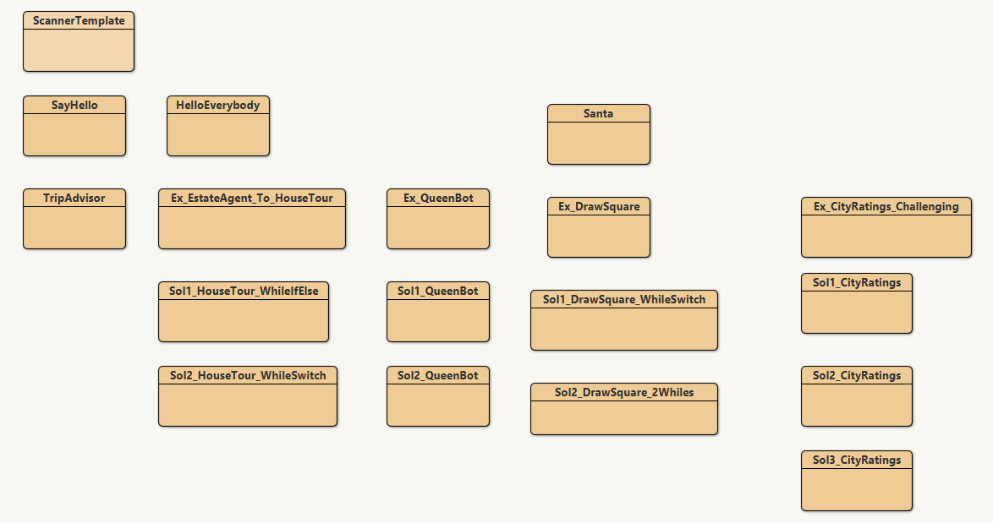
BlueJ Project View - scannerWhile
Screenshot included so you know what the project looks like when opened.
Takeaway: Drag class boxes to organize them; your view may look different.
Challenging Exercise
For Experienced Students

